Slide 1



Interior Point Methods Applied to Predispatch with Network Topology Manipulation Covering Bus and Transmission Lines Simultaneously
Aurelio Oliveira – UNICAMP
Silvia Maria S. Carvalho - UFSCar
Christiano Lyra- UNICAMP

Slide 2
Brazilian System
Interconnected System
Predominantly Hydroelectric
Large Reservoirs
Isolated Systems
± 300 isolated locations
Predominantly Thermoelectric

Slide 3
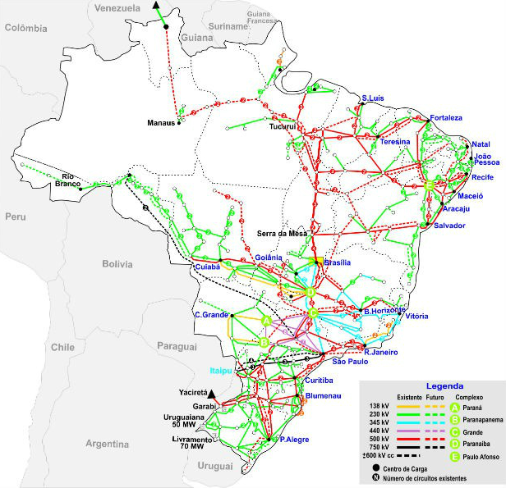
National Interconnected System
Interconnections with about 84,000 kilometers of power lines;
Long transmission lines

Slide 4
Why IPM?
Good performance on large problems
      Robust method;
      Fast convergence.
Primal-Dual IPM
  it is more efficient;
  Starting Point need not be feasible.

Slide 5
Predispatch
  Operational Problem
    Short-Term;
    Meet demands and targets;
    Model
    Minimization of a quadratic function;
    Linear Constraints

Slide 6
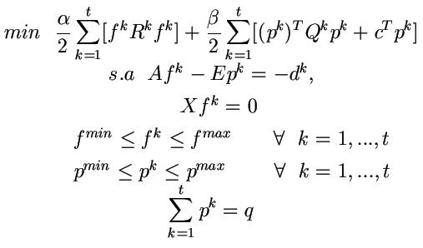
Dynamic Primal Model

Slide 7
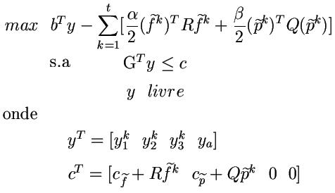
Dual

Slide 8
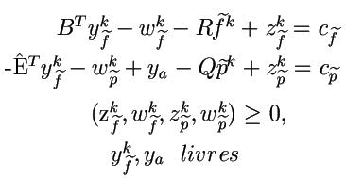
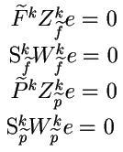
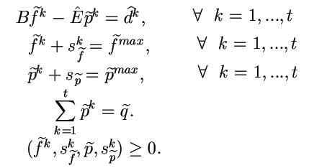
Optimality Conditions
Dual Feasibility
Complementarity conditions
Primal Feasibility

Slide 9
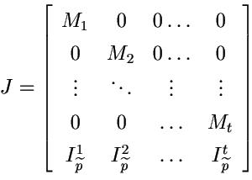
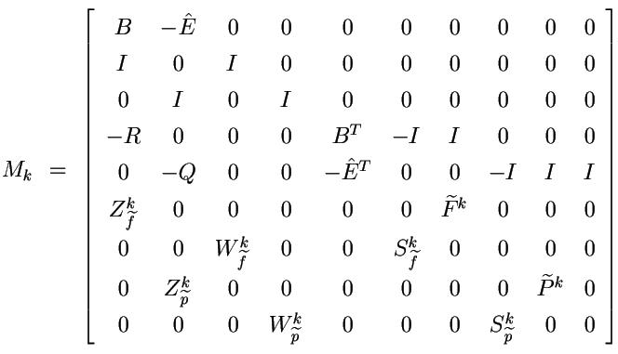
Newton Method
Applying Newton's method:
Jd=r
Where

Slide 10

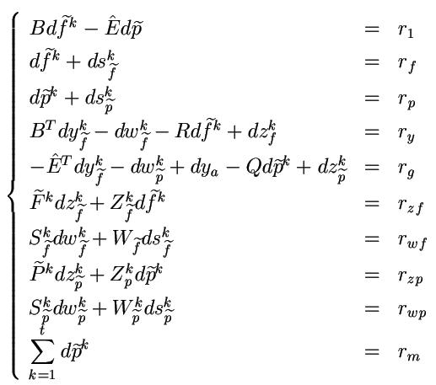
The directions from Newton
Variable substitution

Slide 11
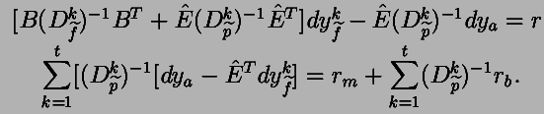
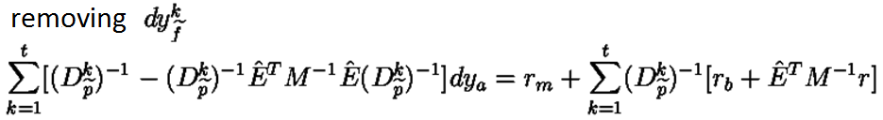
System to be solved

Slide 12

Matrix structure study for the problem with modification in the network topology
Assuming that there were pre-programmed modification in the network topology i;
The matrix B is no longer constant;
Each modification performed, one row and one column of the matrix B are removed (inserted);

Slide 13
Modifications
The modifications are conducted in an attempt to adapt the transmission network to the load change
They are usually held four to six modifications per day for the Brazilian System

Slide 14
Types of Modifications
Lines Modification;
Bus Modification;
Line and Bus Modifications.

Slide 15
Lines Modifications
A branch is removed from the system
The network topology is modified
Incidence and reactance matrix are modified

Slide 16
Maneuvers Bars
Shutdown of a plant
Shutdown of a consumer center;
Change in demand.

Slide 17
Simultaneous Bus and Lines Manipulatons
The bus and line manipulations executed simultaneously characterize more complex changes in the network.
A greater number of rows and columns from the incidence matrix and their respective reactances are removed.

Slide 18
Implementation
Manipulations are given data;
studied networks
  IEEE30 and IEEE118
  BRAZIL1993 and BRAZIL3511

Slide 19
Data from experiments
Variable Number of Manipulations
Developed in Matlab
Accuracy 10⁻³
Intel centrino core 2 duo
4 GB of RAM
Speed 2.13GHZ

Slide 20
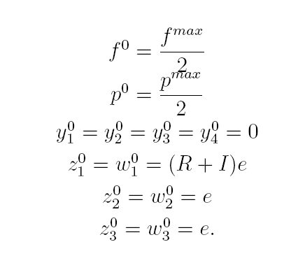
Initial Point

Slide 21
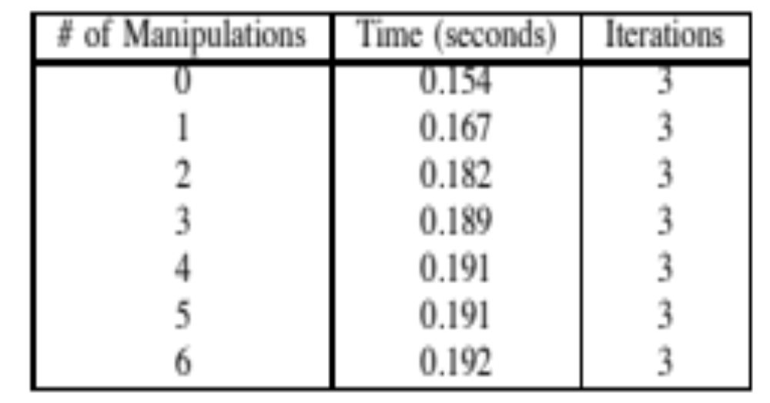
IEEE30 System

Slide 22
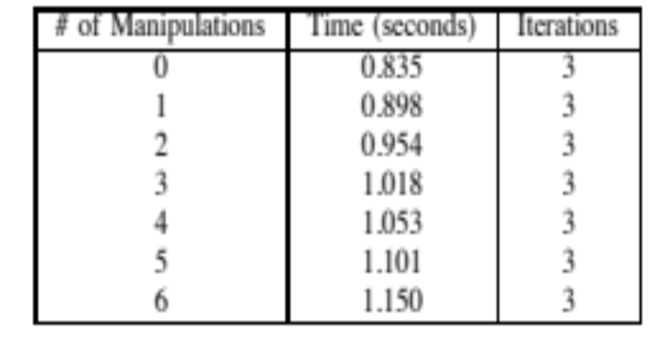
Sistema IEEE118

Slide 23
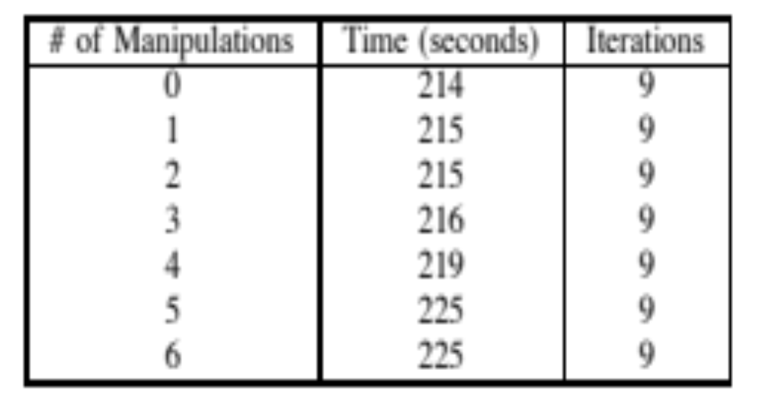
BRAZIL 1993 System

Slide 24
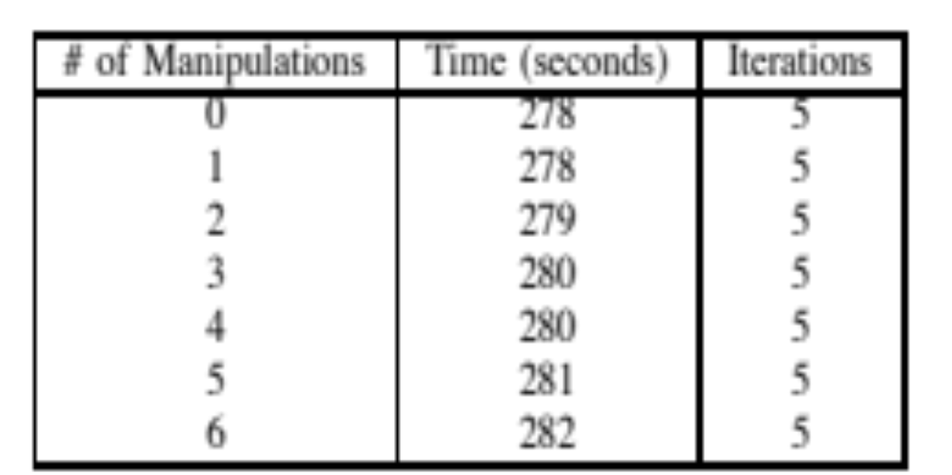
Brazil 3511 System
Real brazilian system

Slide 25
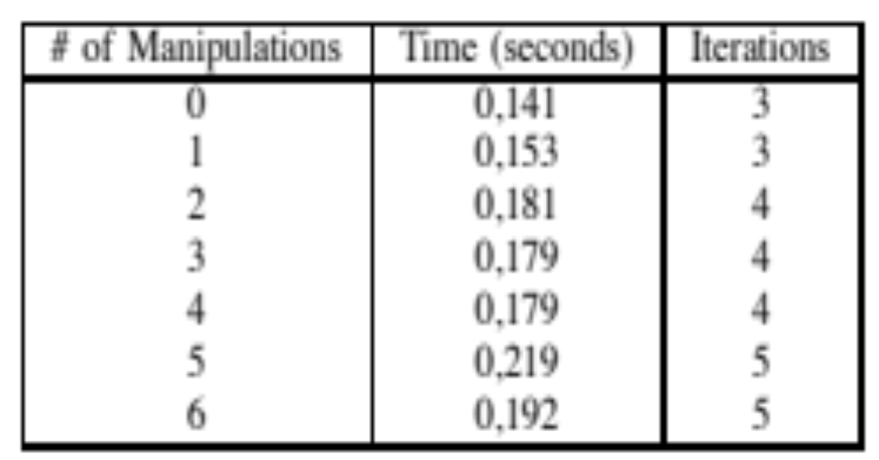
Bus and Lines Modifications
IEEE30 System

Slide 26
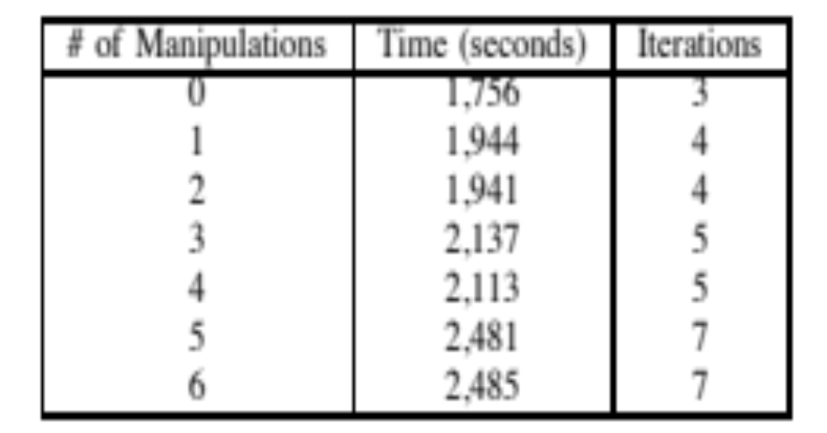
Bars and Lines Manipulations IEEE118 System

Slide 27
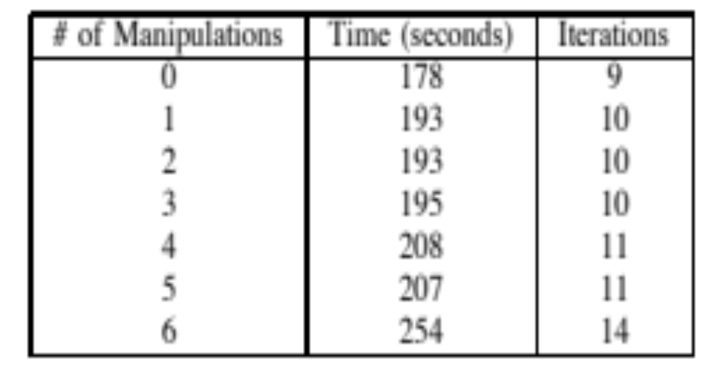
Bars and Lines Manipulations Brazil 1993 System

Slide 28
Conclusions
From the computational point of view, the effort to solve a problem with or without such modifications on the network topology is similar;
B matrix can be factored before the interior point methods application;
The results obtained showed the adequacy of the methodology.
.

Slide 29


